Slide 1

Notes:
Great to see all of you
For those of you who don’t know mw, my name is
Of course, we already had some discussions about your data and I would now like to share my findings with you.

Slide 2
Has there been adequate staff and capacity in the networks?
Notes:
The main business question we discussed is Has there been adequate staff and capacity in the networks
You had provided 4 data sets on
Actual Appointment Duration
Regional Appointments,
National Categories
Tweets from X (formerly Twitter)
To calculate some ratios I also used NHS data on the number of registered Patients and number of GPs.

Slide 3



Approach
Data Import
Data Preparation
Exploratory Analysis
Recommendations
Notes:
I used Python and Jupyter due to the ability to work with large datasets and visualisation options.
In the future we should use something GitHub for real-time collaboration, tracking of changes and access to version history.
Approach: data was imported, reviewed and prepared. The the exploratory analysis led to the recommendations.

Slide 4

How good is the data quality?
What trends does the data reveal?
What are current utilisation rates?
How large is the impact of DNA*?
* “Did not Attend”
Notes:
To analyse the capacity in the networks, we are now going to look at these 4 questions on data quality, trends, utilsation rates and appointments not attended

Slide 5
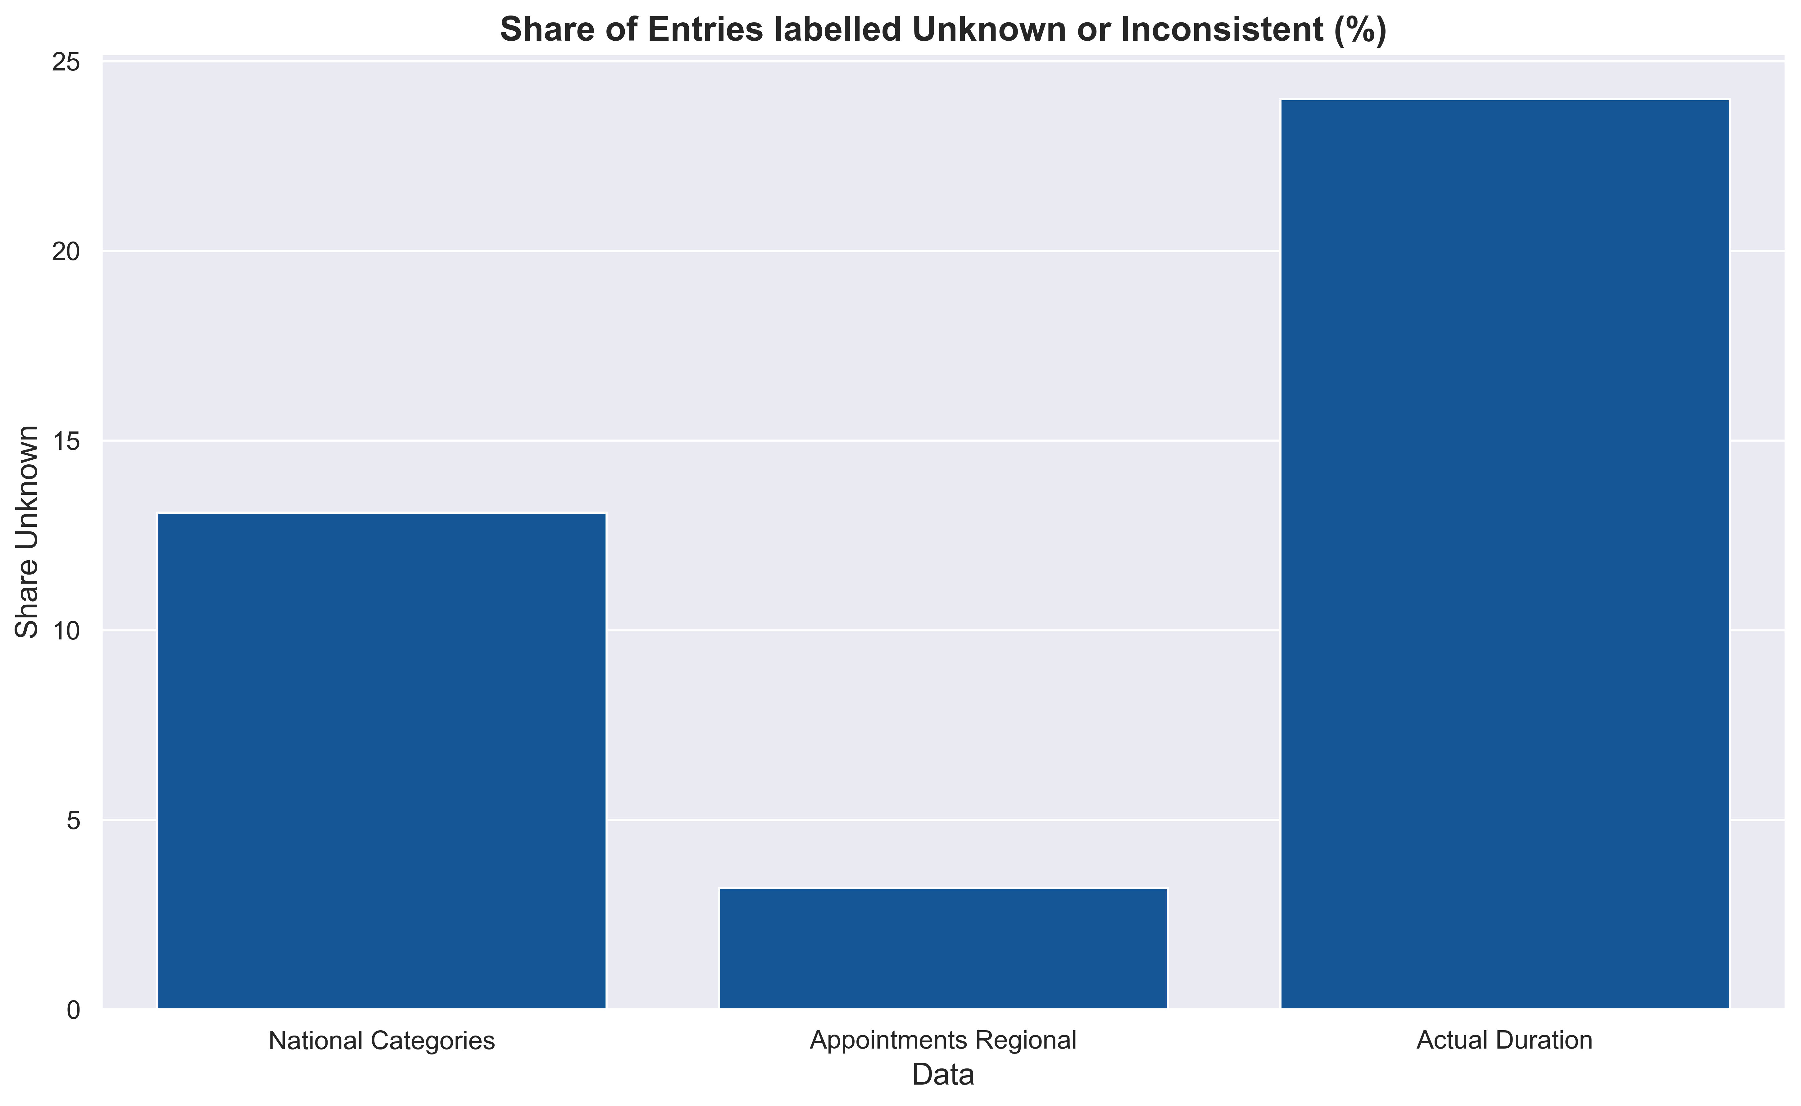
How good is the Data Quality?
24.0%
13.1%
Variations
different practices ➔ different ways
manual classification
different IT system suppliers
Inconsistent mapping
3.2%
unmapped
number of appointments ≠ number of patient contacts
Notes:
Variations in completeness & quality
different practices fill in their records in different ways.
staff manually classifies the data
different IT system suppliers
Here you can see the shares of unknown or inconsistent data in each dataset, with actual duration at 24%.
number of appointments is not equal number of patients seen, as 1 patient may have 2 appointments, one by phone and one face to face.

Slide 6

What trends does the data reveal?

Slide 7
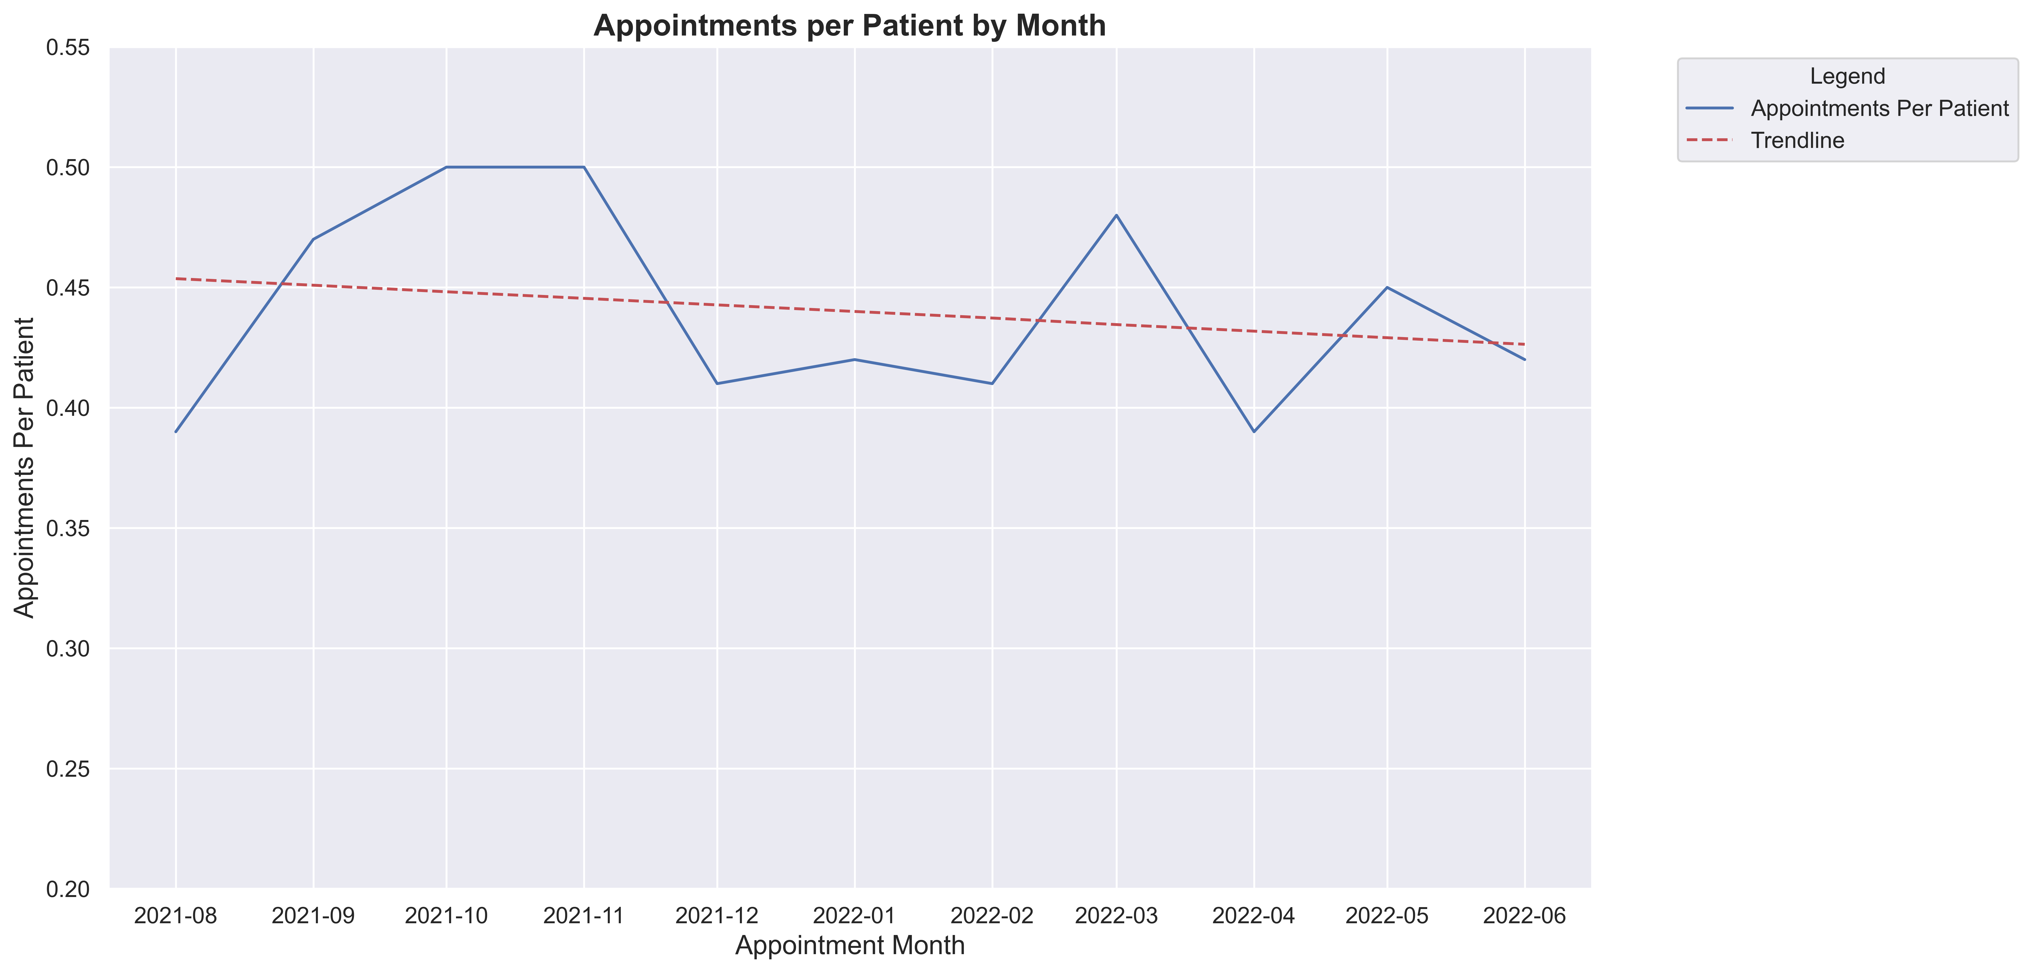
Supply not keeping up with Demand
Increase in registered patients outstrips increase in number of appointments
Notes:
Supply not keeping up with demand.
The chart shows the number of appointments per patient by month
Historically from 2020 the number of appointments has been increasing, but this trend is levelling out as can be seen in the chart from August 2021
Increase in registered patients outstrips increase in number of appointments

Slide 8
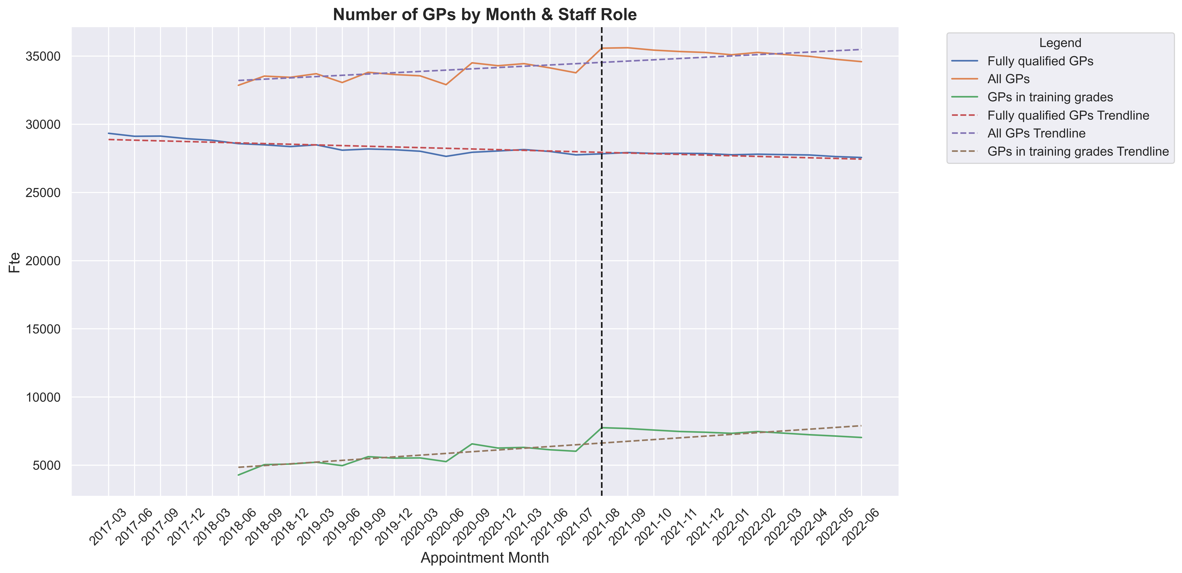
Increasing GP Shortages
2021/2022:
Shortage of 4,200 FTE GPs in (The Health Foundation, July 2022)
Number of patients per GP is increasing
FTE
Notes:
Increasing GP shortages
The graph shows FTE by month since 2017.
Looking at the data from August 2021 as in other data sets,
number of GPs in training has decreased (-9%), so that the number of all GPs has reduced by almost -3%
Already shortage as seen in the data from the health foundation, so the gap will keep increasing.
Result: the number of patients per GP is increasing, which means less availability

Slide 9
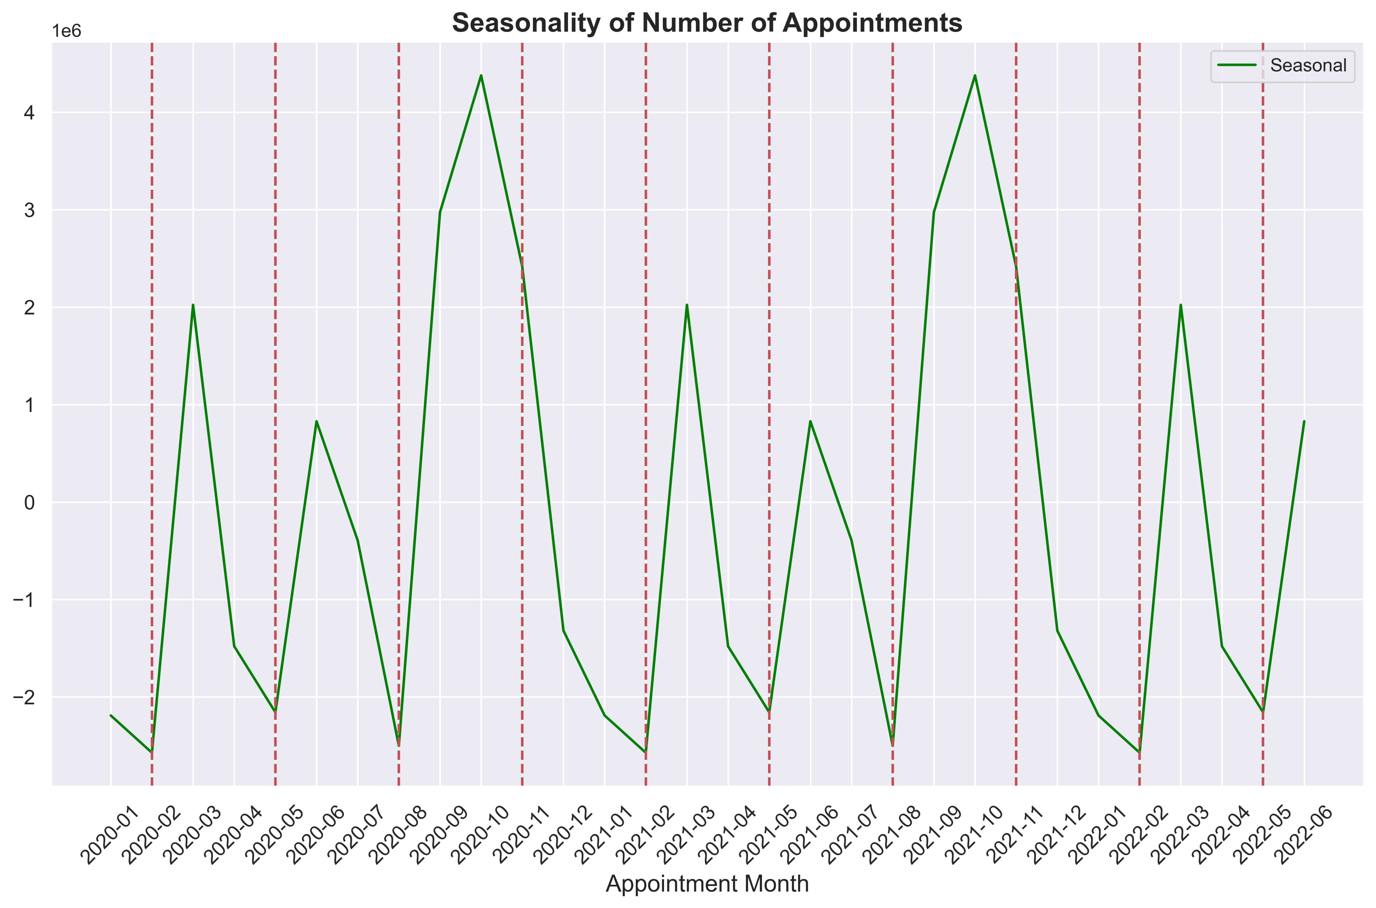
Increasing Pressure
‘Winter Pressure’
‘Winter Pressure’
“…pressure has been building not just at winter but throughout the year.”
(NHS Providers)
Notes:
There is increasing pressure on the networks.
In the UK winter months with colder weather and flu always saw an increase in appointments needed, and the seasonal charts here show increased demand in October and March.
As Covid vaccination appointments are not included in the data, that is not the reason behind the peaks.
However, NHS providers suggest that this pressure has been building not just in winter but throughout the year.

Slide 10
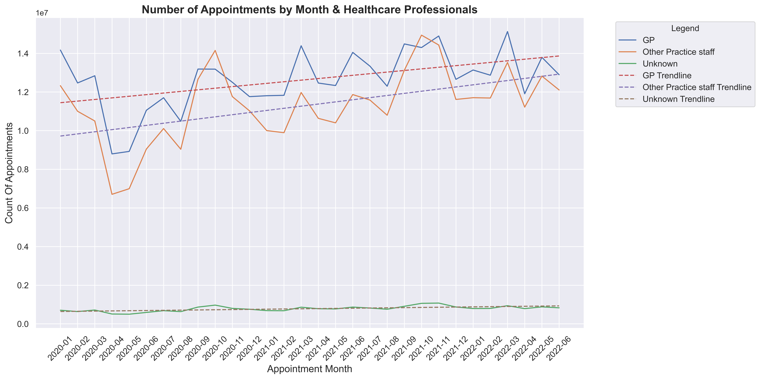
Other Practice Staff cover Peaks
Peak months see more appointments with other practice staff
Notes:
This charts shows appointment by healthcare professional and month.
The blue line is GPs and the orange line is Other Practice Staff.
In the peaks we can see that other practuce staff take more appointments with orange line above blue line.

Slide 11
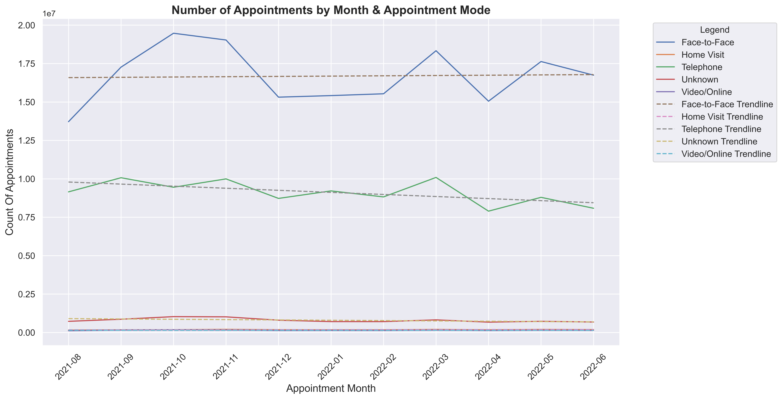
Changing Appointment Modes
Peak times see increase in Face-to-Face appointments
Telephone appointments decreasing
Notes:
Here we see appointent mode (so Face-to-Face, Telephone, Home visit etc.
After an increase in telephone appointment during and after Covid, this is now starting to drop (green line), while Face- to Face is increasing (blue line).
In the peaks face to face appointments are preferred (see October)

Slide 12
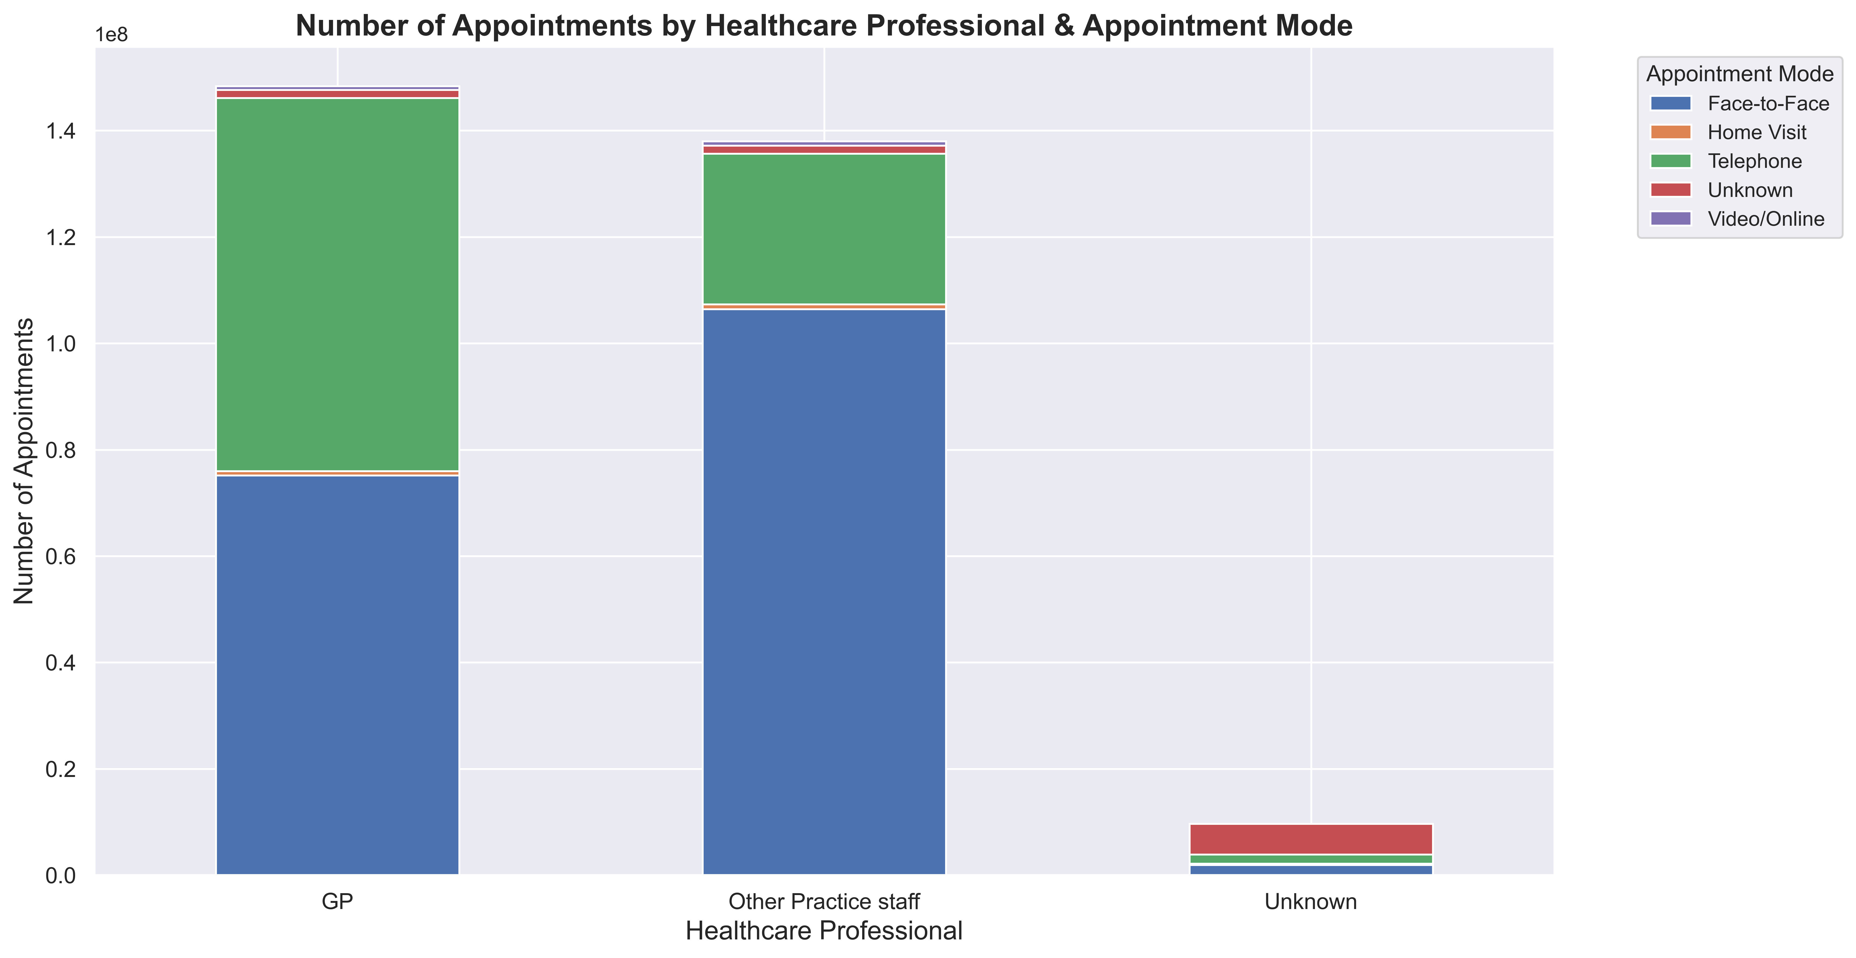
Role of Other Practice Staff
Other Practice Staff take higher share Face-to-Face
GPs take more telephone appointments than other staff
Notes:
When we look at who takes the appointments
Other Practice Staff take a higher share of appointments Face-to-Face (middle bar in blue), while GPs take more Telephone appointments than the Other Practice Staff(left bar in green).
Already saw telephone appointments decreasing & Face-to-Face appointments increasing overall.

Slide 13

What is the current Utilisation Rate?

Slide 14
Utilisation Rate
Utilisation Rate =
# Appointments / Workday
# Average Capacity / Workday
Example June 2022
1,291,404
= 1.08
Utilisation Rate =
1,200,000
Note: Workdays vary between 19 to 23 days per month
NHS: average of 1.2m appointments per day as available capacity
Notes:
How do we calculate utilisation rates.
You stated average capacity per workday as 1.2m.
The analysis of when appointments take place showed most appointments taken Mon-Fri in normal practice working ours.
Appointments per workday based on the workdays per month form the NHS files (between 19 & 23 days)
In June 22

Slide 15
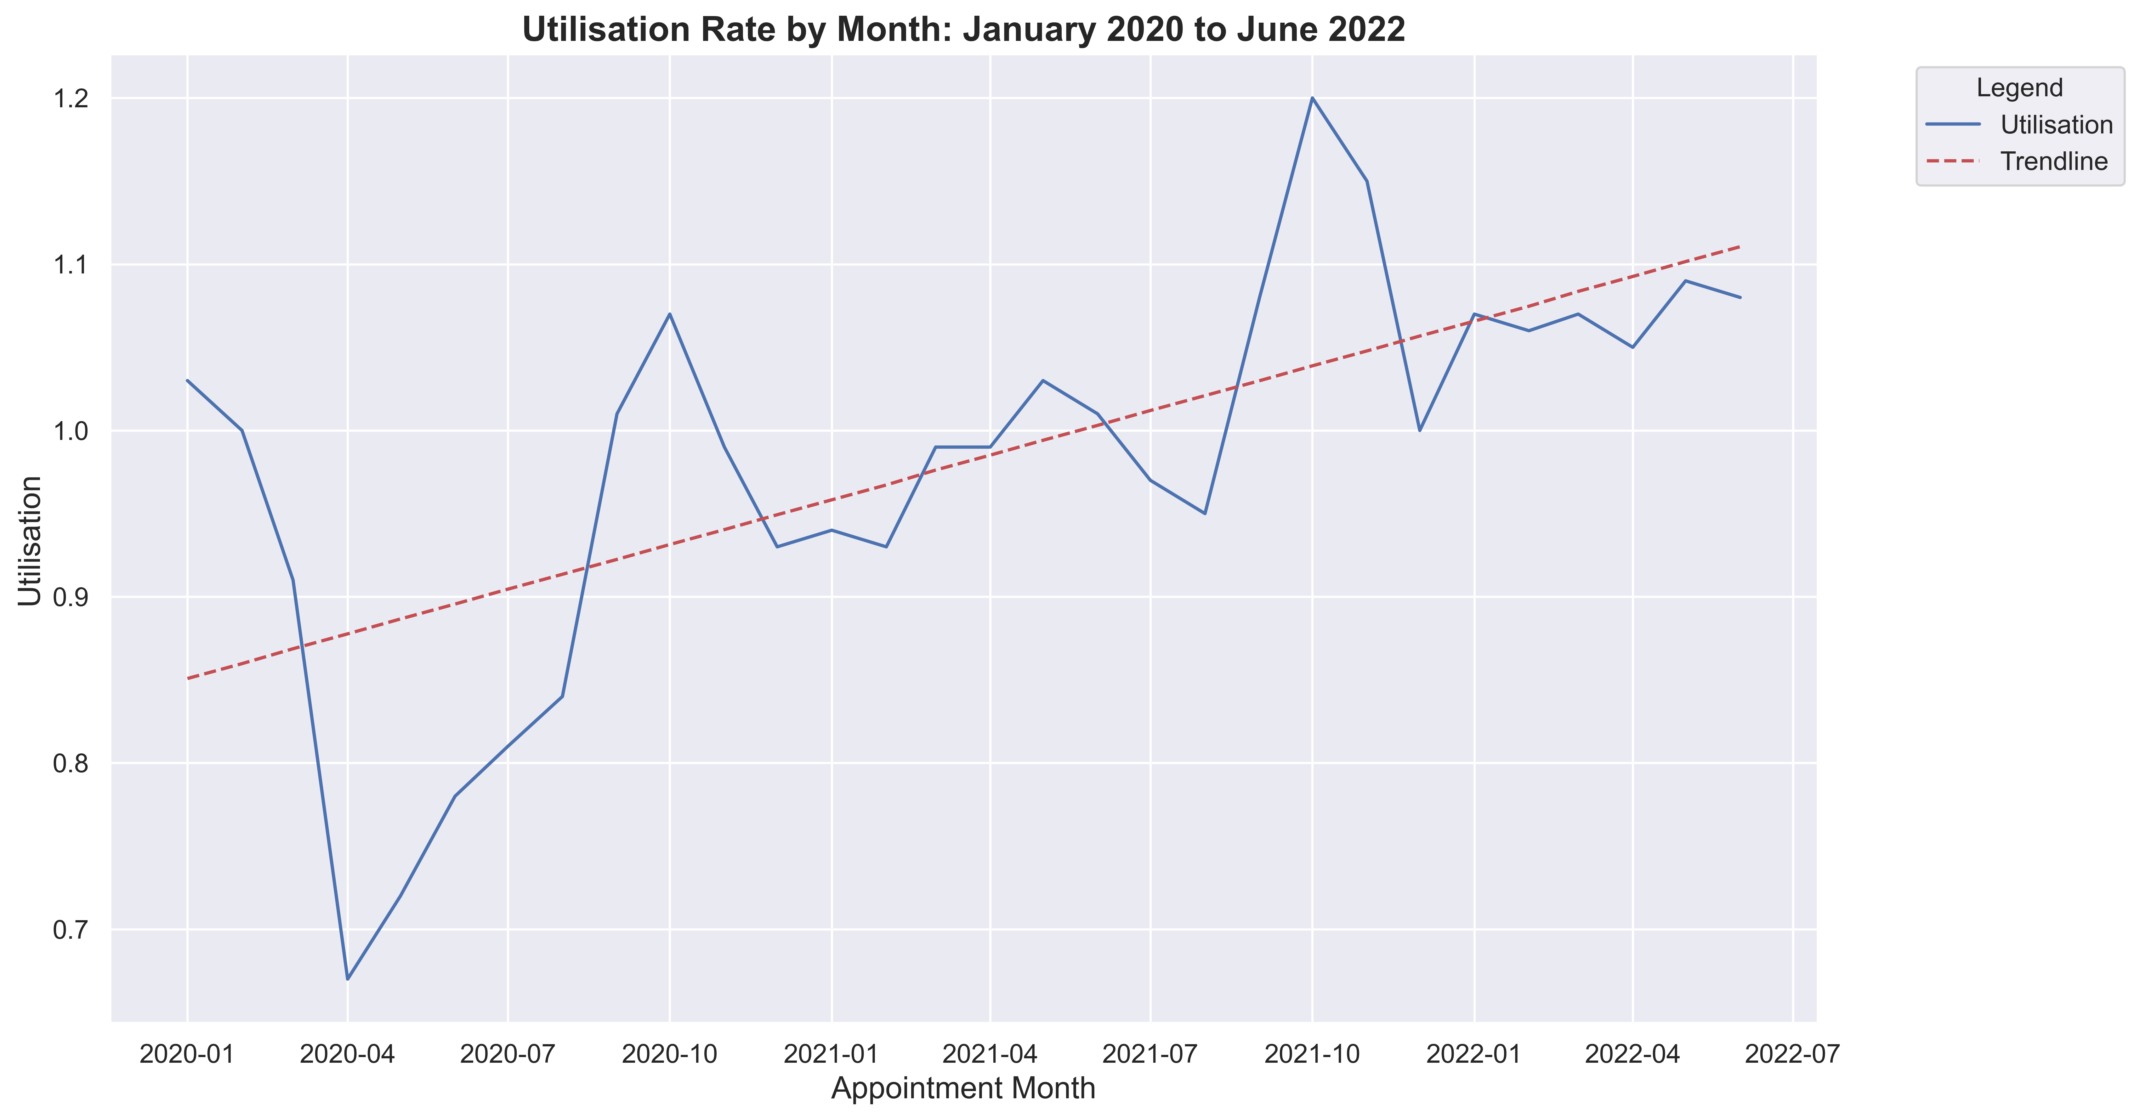
Upward Trend in Utilisation Rate
Utilisation Rate > 1 means there is more demand than average monthly capacity
Utilisation Rate
Notes:
Upward trend in utilisation as charted here from January 2020
The grey line is 1, so utilisation rate >1 means that there is more demand than average monthly capacity.
Further research is necessary into how this is achieved on a regular basis - maybe appointments are shortened to have more availability per day or the average daily availability of appointments is greater than 1.2m.

Slide 16
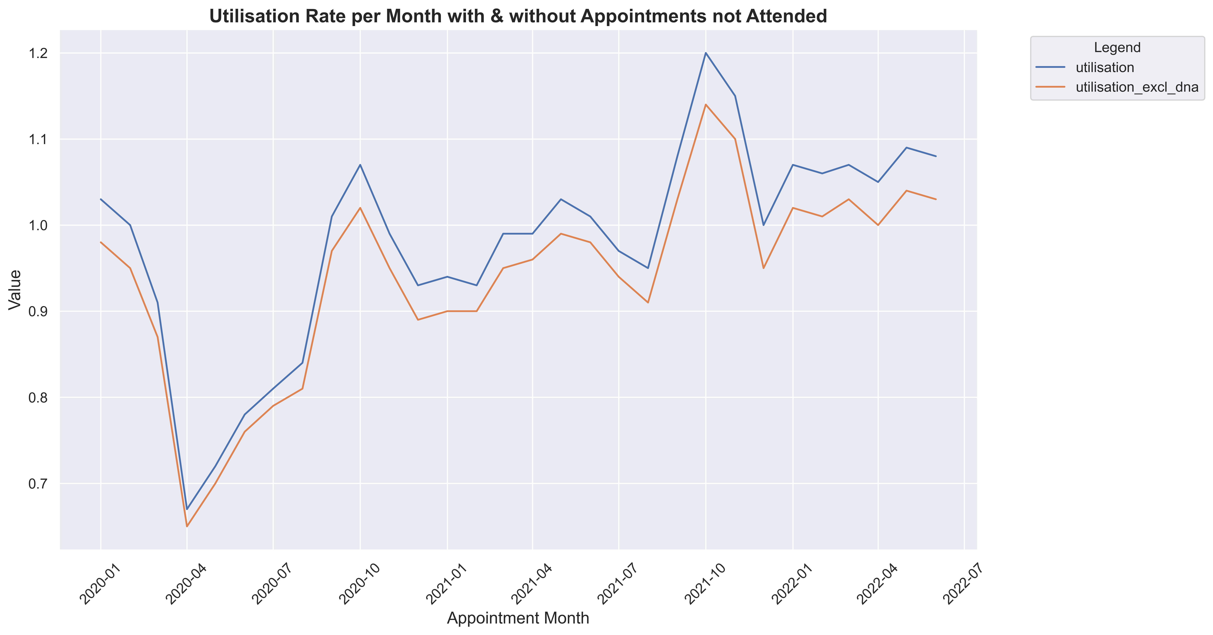
Impact of DNA on Utilisation
Utilisation
Utilisation excl. DNA
Even without DNA there is more demand than average capacity.
The number of appointments not attended is increasing.
Utilisation Rate
Notes:
Of course if there is a large number of appointments not attended, the real utilisation will be lower, which we see in the orange line here.
But still the line is above 1 from January 2022 and the number of appointments not attended is increasing.

Slide 17
“Did not Attend”
(DNA)
Notes:
It is worth looking at appointments not attended in more detail

Slide 18
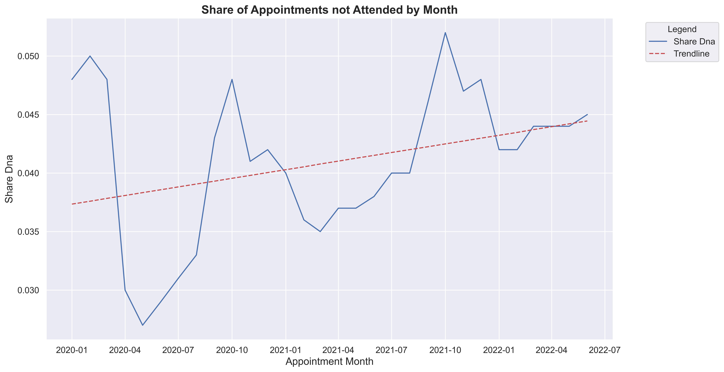
Upward Trend in Appointments not Attended
Share DNA
Trendline
Share of appointments not attended is increasing.
Share DNA
Notes:
We have already established that there is an upward trend of the share of appointments not attended

Slide 19
Reasons for Missing Appointments
forgetting appointments
being too ill to attend
feeling better
work & family commitments
transport problems
appointment not with a preferred GP
difficulty cancelling appointments
Notes:
Studies about the reasons for missing appointments
This is also reflected in our data

Slide 20
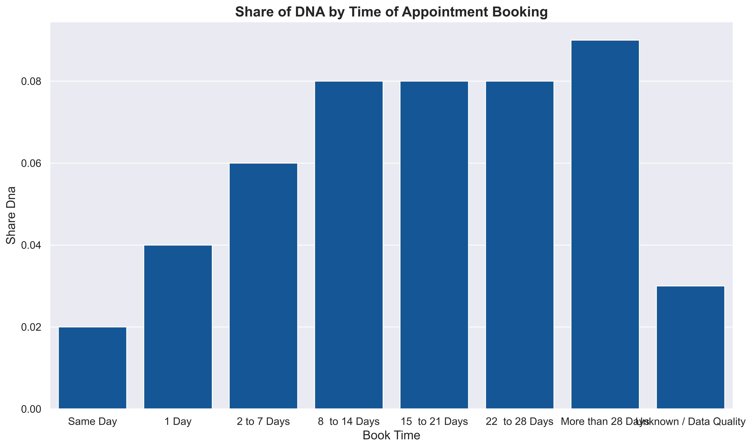
Reasons for Missing Appointments
➔ Booking further in advance
forgetting appointments
being too ill to attend
feeling better
work & family commitments
transport problems
not with a preferred GP
difficulty cancelling
9%
Share DNA
2%
> 28 Days Unknown
Notes:
the further in advance appointment is booked, the greater the percentage of appointments not attended
tallest bar 28 or more days in advance, 9% of appointments are not attended
compared to 2% of same day appintments

Slide 21
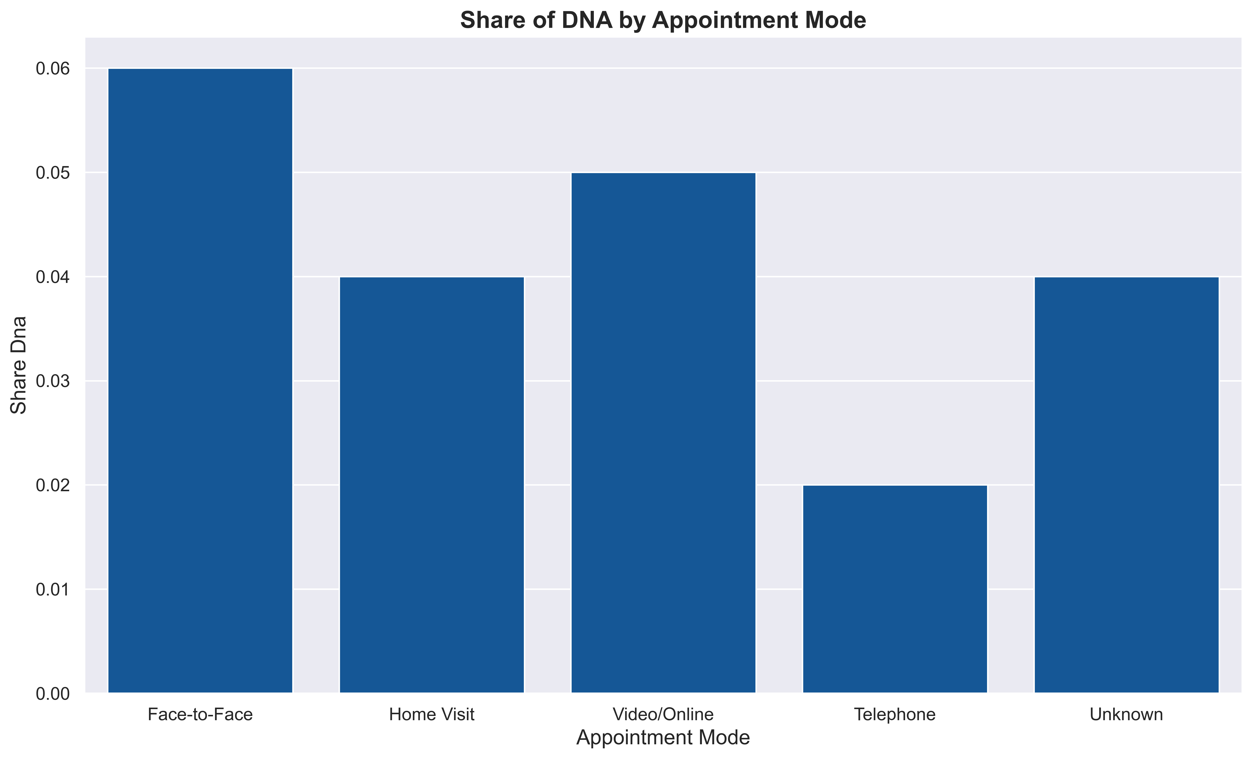
Reasons for Missing Appointments
➔ Fewer telephone appointments not attended
forgetting appointments
being too ill to attend
feeling better
work & family commitments
transport problems
not with a preferred GP
difficulty cancelling
6%
Share DNA
2%
Notes:
by appointment mode, only 2% of telephone appointments not attended
while 6% of face to face appointments

Slide 22
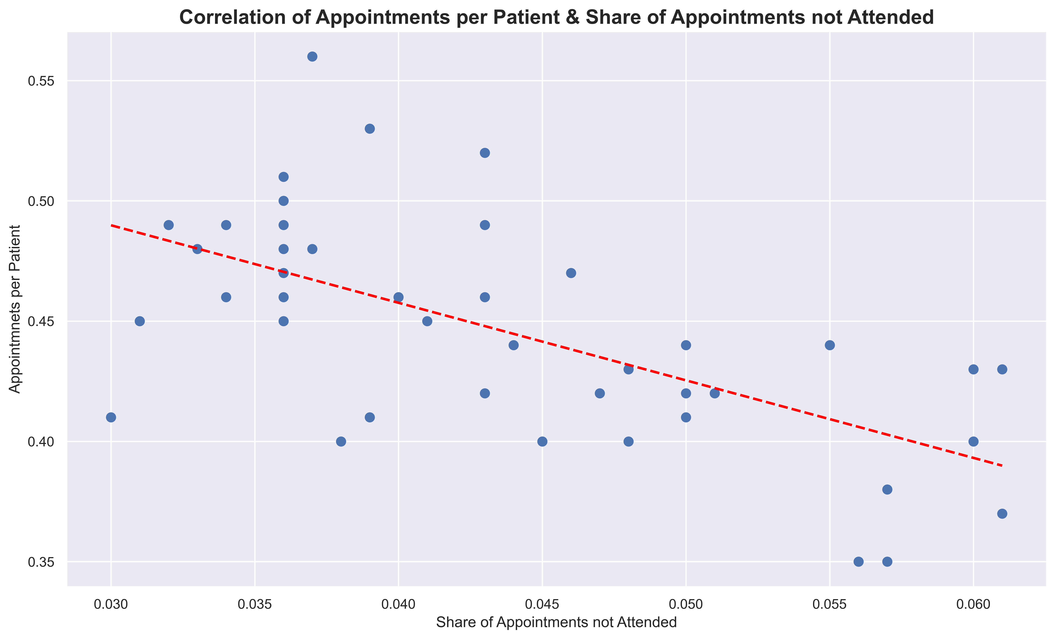
Reasons for Missing Appointments
➔ Fewer appointments per patient
forgetting appointments
being too ill to attend
feeling better
work & family commitments
transport problems
not with a preferred GP
difficulty cancelling
Notes:
This chart shows data by ICB with the correlation between appointments per patient and appointments not attended
Which means fewer appointments per patients means higher rate of appointments not attended

Slide 23
The Cost of Appointments not Attended
13,318,384 appointments
were not attended in 11 months
equivalent to 11 more workdays
or at least £115m
From August 2021 to June 2022
Assuming appointment cost with GP of £30 for 3.8m appointments
Notes:
The cost of appointments not attended is huge to the NHS.
in the 11 Months we looked at (so August 2021 to June 2022) 13m appointments were not attended.
That is the equivalent of 11 more workdays or 115m GBP (3.8m of the 13m appointments were taken by GPs and you assume 30 GBP for an appointment)

Slide 24

Conclusion
GP shortages
Increase in Registered Patients
Increase in Utilisation Rate
➔ demand for more capacity
Notes:
In conclusion,
GP shortages
an increase in Registered Patients
and an increase in Utilisation Rate
mean that there is demand for more capacity

Slide 25

Recommendations
Notes:
So now we are coming to recommendations
If due to budget constraints and fewer GPs in training, hiring more staff is not an option, actions can be taken to improve availaibility with current staff levels.

Slide 26
Improving Data Quality
Better Data = Better Decisions
Notes:
One is imporving data quality, because better data equals better decisions

Slide 27
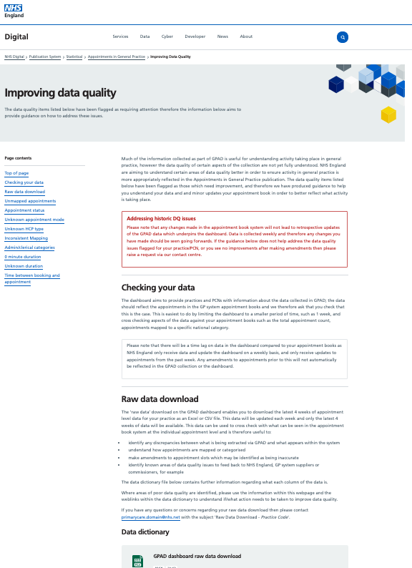
Improving Data Quality
Access to training & support for digital tools
Target Audience: GPs & Practice Teams
Resource: NHS Website & Training Teams
Introduce National Standards for Data Entry
NHS Website
Notes:
This should be done by giving Practice Teams access to training and support for the digital tools, for eaxmple via the NHS Website,
ans also introducing national standards for data entry,

Slide 28
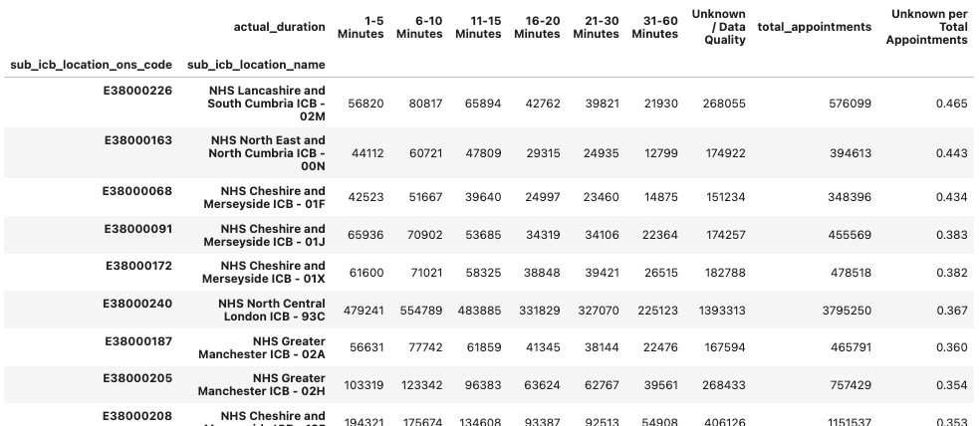
Improving Data Quality
Start with Sub-ICBs with most quality issues
Area: Actual appointment duration
Who: 20 of 106 Sub-ICBs
Issue: Share of Unknown / Data Quality Issues > 30%
Incomplete Data Extract
Notes:
It would be best to start with the Sub-ICBs with the highest share of quality issues in their data

Slide 29
Increasing Resources & Capacity
Increase availability of appointments
Use available resources more effectively
Notes:
The second recommendation is to
Increase availability of appointments and to use available resources more effectively

Slide 30
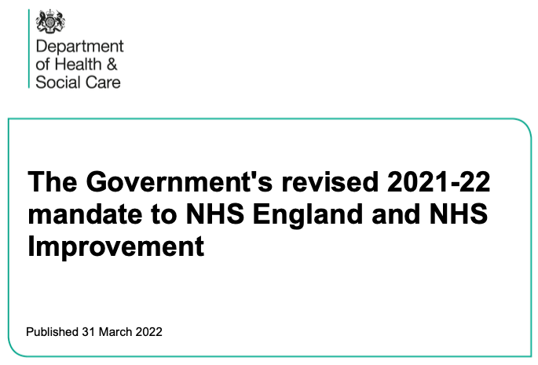
Increasing Capacity
Implement Government Mandate
Increase appointments carried out by Other Practice Staff
Healthcare Professional Type | Healthcare Professional
GP | GP Registrar
GP | Locum GP
GP | Principal GP
Other Practice staff | Acupuncturist
Other Practice staff | Chiropodist
Other Practice staff | Community Psychiatric Nurse
Other Practice staff | Counsellor
Other Practice staff | Dispenser
Other Practice staff | District Nurse
Other Practice staff | Health Visitor
Other Practice staff | Interpreter/Link Worker
Other Practice staff | Osteopath
Other Practice staff | Other Practice Staff
Other Practice staff | Physiotherapist
Other Practice staff | Practice Nurse
ensuring that patients who need an appointment get one within 2 weeks
Notes:
Capacity can be increased by implementing the planned government mandate
and by increasing appointments carried out by other practice staff - highlighted in blue. More research must be done into who takes on which appointments currently and potentially in the future.

Slide 31
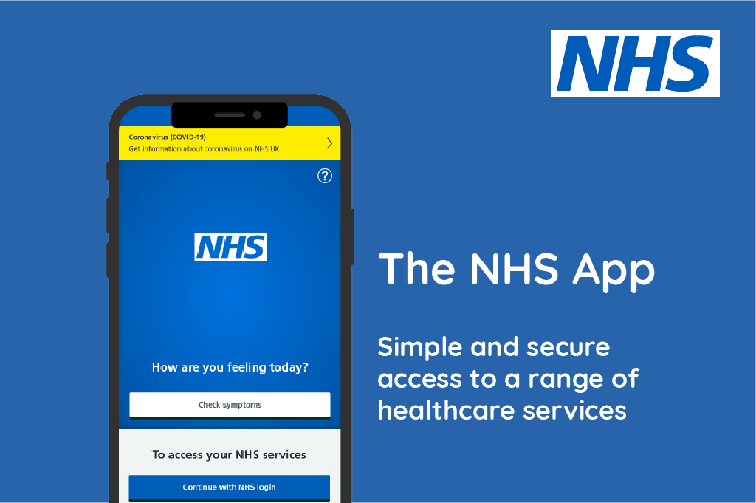
Reducing Appointments not Attended
Expand the use of the NHS App
Encourage use of NHS 111
or use the NHS App
Notes:
To increase the availability of appointments, the appointments not attended mustbe reduced.
Therefore, the use of the NHS app should be expanded.
It can send SMS reminders for appointments to encourage patients to keep their appointments or cancel them in a timely manner.
If you look manage your appointments and look up your records on the app, this will further reduce pressure on practice staff.
No. of appointments viewed/ managed in Nove 2022: 1.9m

Slide 32
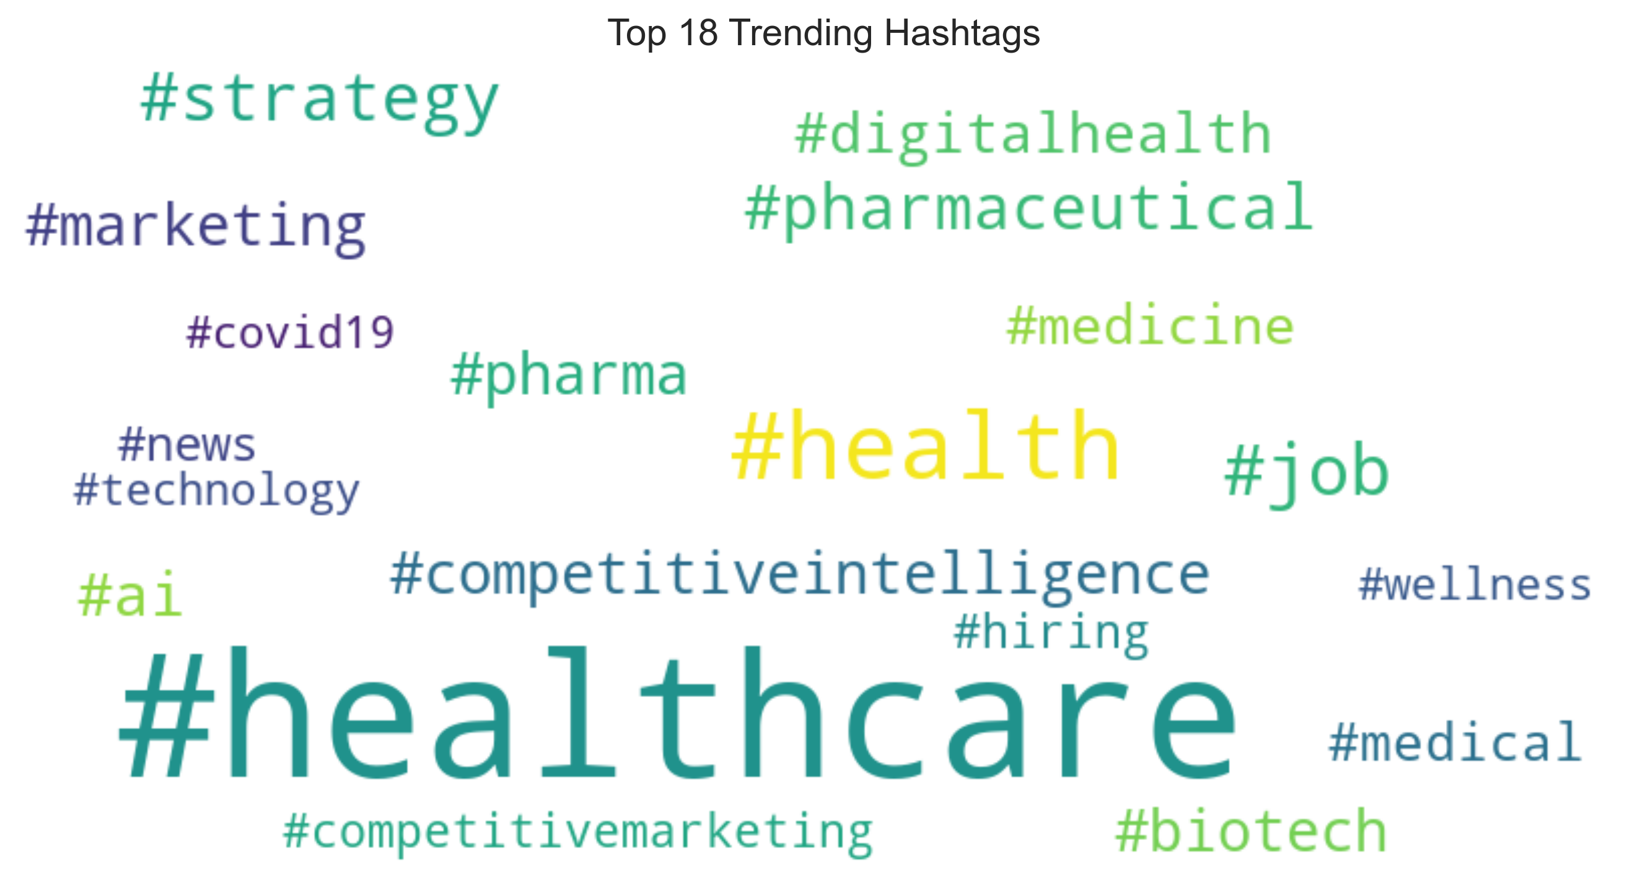
Raising Awareness with Social Media
Top 18 trending hashtags around healthcare
Notes:
You can use social media to increase awareness about the cost of appointments not attended and to encourage the use of the NHS App
Looking at trending health hashtags, healthcare is already the top hashtag and can be expanded on.
Use hashtags to improve visibility
Use live tweets to generate interest & attention
Work with influencers

Slide 33
Next Steps
Set Target:
additional 7.2m appointments
equivalent to 6 more workdays/ year
Notes:
What are the next steps to increase capacity in the networks and use the resources most effectively Set a target - e.g. 7.2m additional appointments
which is basically like halving the number of appointments not attended or increasing appointments with other staff
and is the equivalent of gaining another 6 workdays in a year

Slide 34
Next Steps
Formulate KPIs
Data Quality
App Users
Role Other Practice Staff
Reduction in DNA
Notes:
Generally set KPIs & targets to track progress
For data quality a percentage could be set for reducing unknowns
For the app a target of doubling the number of appointments managed in the app could be set
And to deepen the analysis the research should be carried out on anonymised patient level in addition to number of appointments.

Slide 35
Notes:
Thank you very much and I am available to answer any questions.

